Slide 1
Hands-On Session: PIRCHE Results

Slide 2
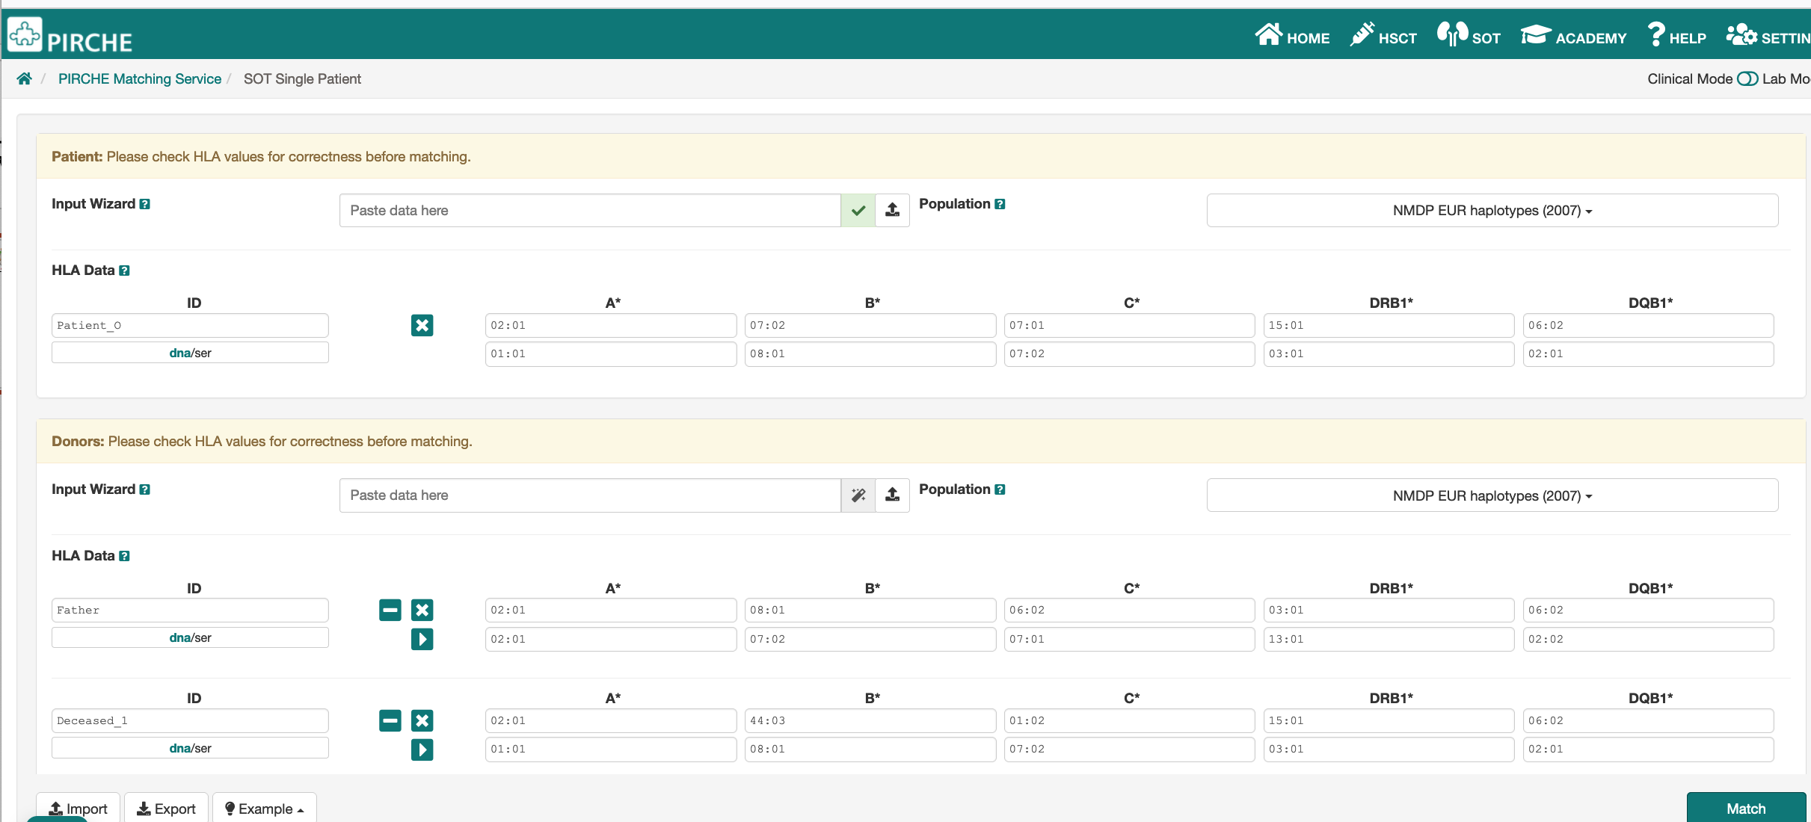
Input

Slide 3
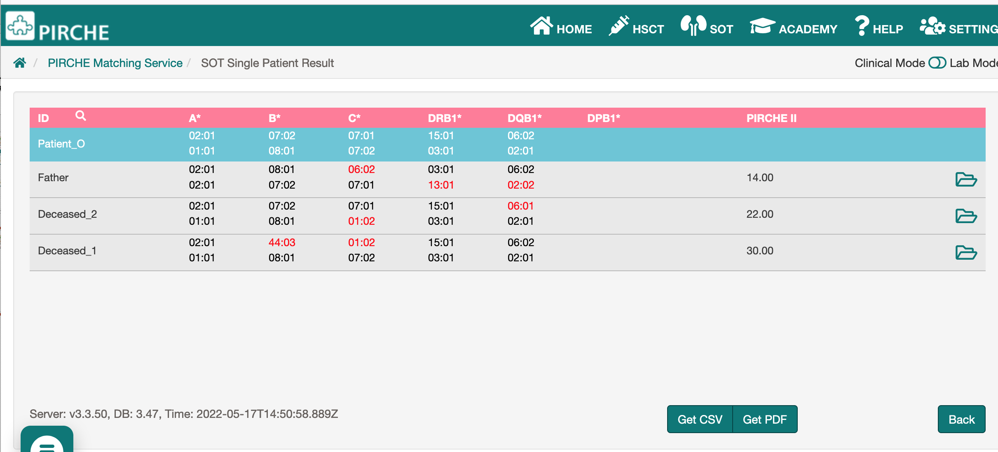
Results

Slide 4
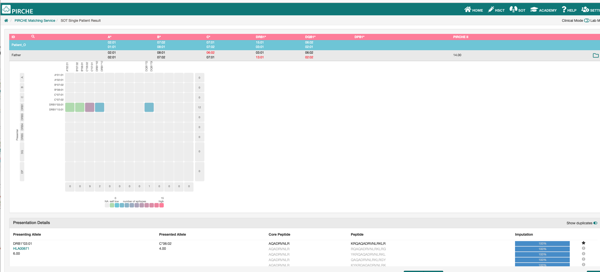
Epitope numbers

Slide 5
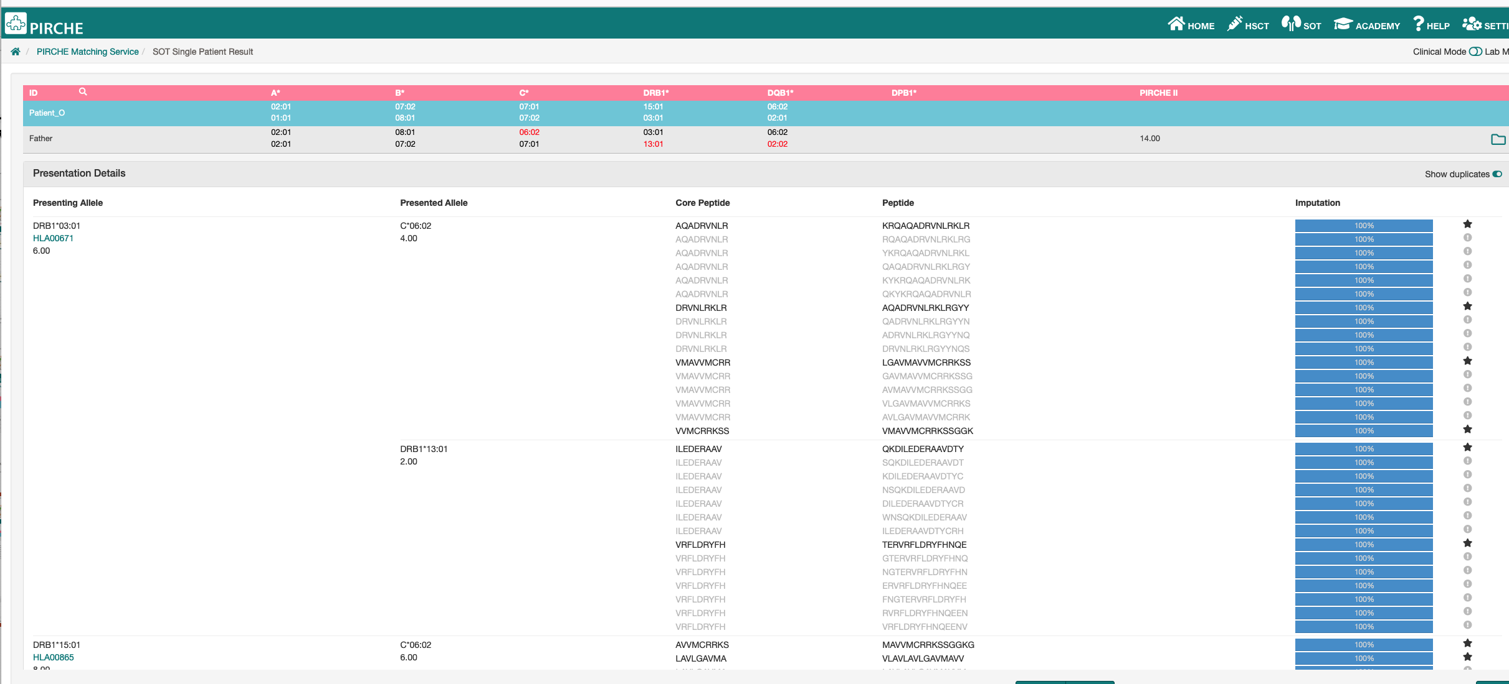
Epitopes in detail

